Slide 1
Cohesion of Translated Language
Ibrahim Alasmri
SYDNEY UNI

Slide 2
The Practice of Translation
Go far back in record history
Translating of cultural & religious texts & concepts
Cicero & Horace (1st Century BC)
St Jerome (4th Century )
Islamic Translation (7th Century)

Slide 3
Study of Translation Field
Developed in an academic discipline only in later part of (20th Century)
Before 20th Century, it was considered as an element of language learning

Slide 4
Translation Studies
"The name and nature of translation studies“
1972 - 1988

Slide 5
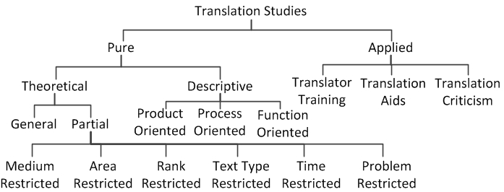
Holmes/Toury Map of Translation Studies

Slide 6
History of Translation Studies
Before 1970s
“Linguistic-Oriented” science of translation – Contrastive Linguistics
The Concept of Equivalence 1950s-1960s
“more systematic analysis – meaning and equivalence ”
Text Type & Text Purpose
“Skopose theory in Germany”

Slide 7
History of Translation Studies
Descriptive Approach1980s
“ Polysystem theory & Literature ”
Gender & Postcolonial research 1990s
Discourse Analysis 1990s
“ Halliday systematic functional model”
Was employed in many works such as;
Translation Quality Assessment (House)
In Other Word (Baker)
Discourse & Translator (Hatim & Mason)

Slide 8
Discourse Analysis
1990s , came to prominence in Translation Studies.
“Systemic Functional Linguistics (SFL)”
Textual meaning & its frameworks.
(thematic progression, theme & rheme, and cohesion)

Slide 9
Cohesion
cohesion model.
Its definition & patterns.
My research project

Slide 10
References
Abdul-maqsod, H. (2007). Cohesion; Foundations and Objectives. Paper presented at the The Third International Conference, Faculty of Dar Al Uloom, Minia University.
Al-Jubouri, A. & Knowles, F. (1988). A Computer-assisted Study of Cohesion Based on English and Arabic Corpora: An internet report, in Proceedings of the 12the international ALLC, Congress, Geneva: ALLC.
Baker, M. ( 2011). In Other word - A Course Book on Translation (2nd edition ed.). London/New York: Rotledge.
Butt, D., Macquarie University. National Centre for English Language, T., & Research. (2012).Using functional grammar: an explorer's guide. Sydney: National Centre for English Language Teaching and Research, Macquarie University.
Hasan, R., & Halliday, M. A. K. (1976). Cohesion in English (Vol. no. 9.). London: Longman.
Hatim, B., & Mason, I. (1990). Discourse and the translator. London: Longman.
Holes, C. (1984). Modern Arabic: structures, functions, and varieties. New York: Longman.
Munday, J. (2012). Introducing translation studies: theories and applications. Abingdon, Oxon: Routledge.

