Slide 1
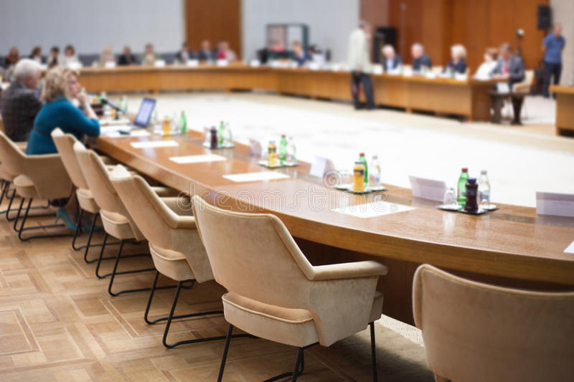
Roundtable Discussion about Translation
Moderator
Dr. Amal Metwally
Speakers
Asma Alahmari
Raghad Alqahtani
Rafif Najmi

Slide 2
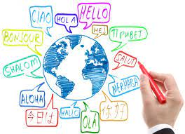
Translation is not a matter of words only: it is a matter of making intelligible a whole culture.
— Anthony Burgess

Slide 3
“Translation is that which transforms everything so that nothing changes” Günter Grass

Slide 4
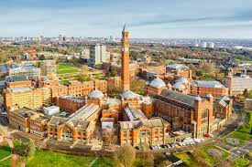
Asma Alahmari
Lecturer at KKU, Faculty of Languages and Translation, Abha.
- BA in English language, KKU
- Higher diploma in teaching ESL, KKU
- MA in Translation Studies, University of Birmingham 2019- 2021

Slide 5
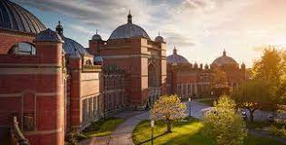
Raghad Alqahtani
- BA in English language, KKU
- MA in Translation Studies, University of Birmingham 2020

Slide 6
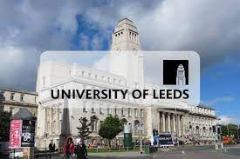
Rafif Najmi
- Lecturer at KKU, Faculty of Languages and Translation, Abha.
- BA in English language, KKU, 2012
- MA in Arabic/English Translation, University of Leeds, England ,2020

