Slide 1
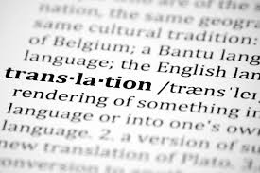
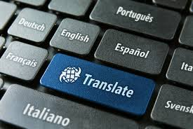
Translation: A Broad Overview weaving its threads together
Dr Eyhab Bader Eddin
English Department, Faculty of Languages and Translation
King Khalid University
October 1, 2019

Slide 2
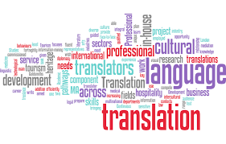
Points to Discuss today:
1. Translation History
2. Translation Definition
3. Translation Importance
4. Translation Modes
5. Distinction between Translation and interpreting
6. Real Examples
7. Difficulties

Slide 3
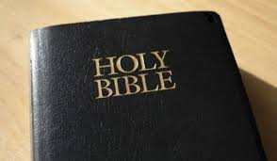
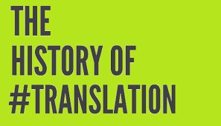
History
The translation of the Hebrew Bible into Greek in the 3rd century BC is regarded as the first major translation in the Western world.
The dispersed Jews had forgotten Hebrew, their ancestral language, and needed the Bible to be translated into Greek to be able to read it.

Slide 4
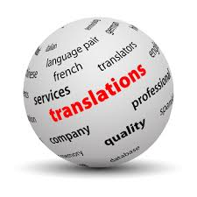
Definition
The process of replacing a text in one language by a text in another.
An act through which the content of a text is transferred from the source language into the target language.

Slide 5
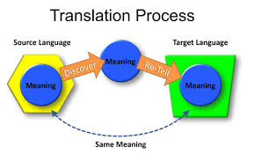
Source text vs target text

Slide 6
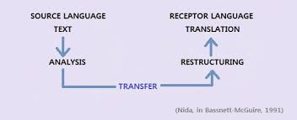

Slide 7
Translation Importance
The need for translation has been apparent since the earliest days of human interaction, whether it be for emotional, trade or survival purposes.
Spread of civilizations, sciences, knowledge, religions, negotiating treaties and accords in peace and war.
The demand for translation services has continued to develop and is now more vital than ever, with businesses acknowledging the inability to expand internationally or succeed in penetrating foreign markets without translating marketing material

Slide 8
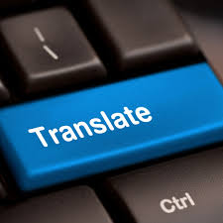
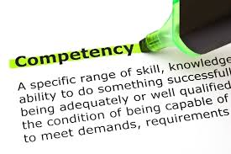
CHARACTERISTICS of a Competent Translator
A. Linguistic command of both SL and TL.
B. Thorough knowledge of the subject matter of the translated text.
C. Inspiration, flair for language
D. Cultural acquaintance with the TL culture.
E. Flexibility in understanding the same words in different contexts (any examples?)

Slide 9
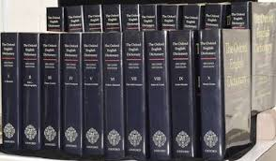
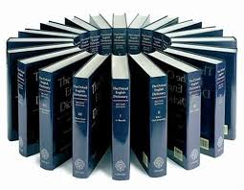
An important tool of a good translator is a good dictionary
Dictionaries come in many shapes and sizes
They are aimed at different groups of users.
No dictionary is totally comprehensive, in the sense that it contains ALL the words in the language.
Even the great TWENTY-VOLUME second edition of the Oxford English Dictionary, with its 291, 500 entries) needs to be reviewed and updated for new senses of existing words AND new words coined.

Slide 10
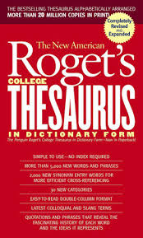
What information could a good dictionary provide to its user?
learning new words
learning the origin of a word
checking the parts of speech of a word
learning multiple meanings of a word
learning how to pronounce a word
constructing a sentence using the word

Slide 12
Following is a list of the most famous reliable dictionaries you may buy and keep for your own

Slide 13
Gird your loins and work on the following set of statements
Australian taxi protests stop traffic
…………………………………………………………………..
Australia and Indonesia restore full military ties
…………………………………………………………….

Slide 14
Flags flew at half-mast across the country on a national day of mourning
Trump threatens Iran over uranium enrichment

Slide 15
Distinction between translation and interpreting
Translation | Interpreting
Written language | Oral language
Author and addresses are NOT present Result? No overt interaction or direct feedback | BOTH Author and addresses are present Result? Overt interaction and direct feedback
Tools available, and not under the pressure of time | Able to translate in both directions on the spot, without using dictionaries or other supplemental reference materials
 | Must have extraordinary listening abilities, especially for simultaneous interpreting
 | Need to process and memorize the words that the source-language speaker is saying now, while simultaneously outputting in the target language the translation of words
 | Must also possess excellent public speaking skills and the intellectual capacity to instantly transform idioms, colloquialisms and other culturally-specific references into analogous statements the target audience will understand.

Slide 16
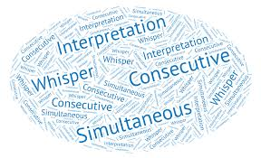
Why difficult?
No breaks
Specialized vocabulary and high levels of speech (thorough knowledge of the subject matter)
Speed
Stress
Decalage (ear to voice span): the time between the speaker’s utterance and interpreter’s interpretation of that utterance.
Listening while speaking

Slide 17
For further discussion, please contact me at ealdeen@kku.edu.sa

